Slide 1


A and Aa Matra Words
Matra Words

Slide 2
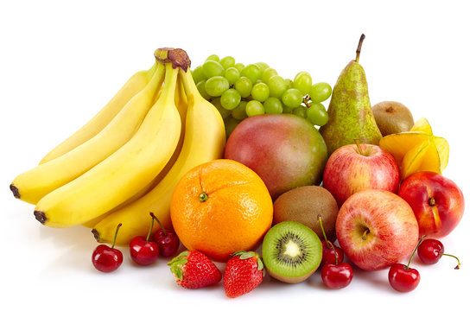
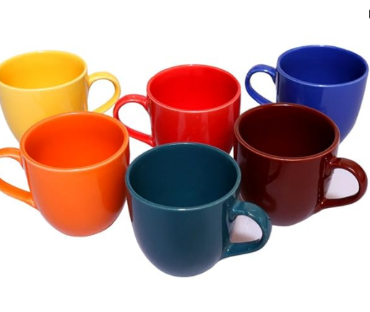
A and Aa Matra Words
Cup
Fruits

Slide 3
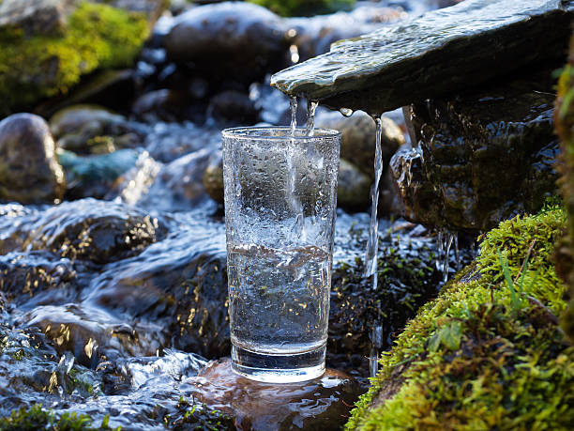
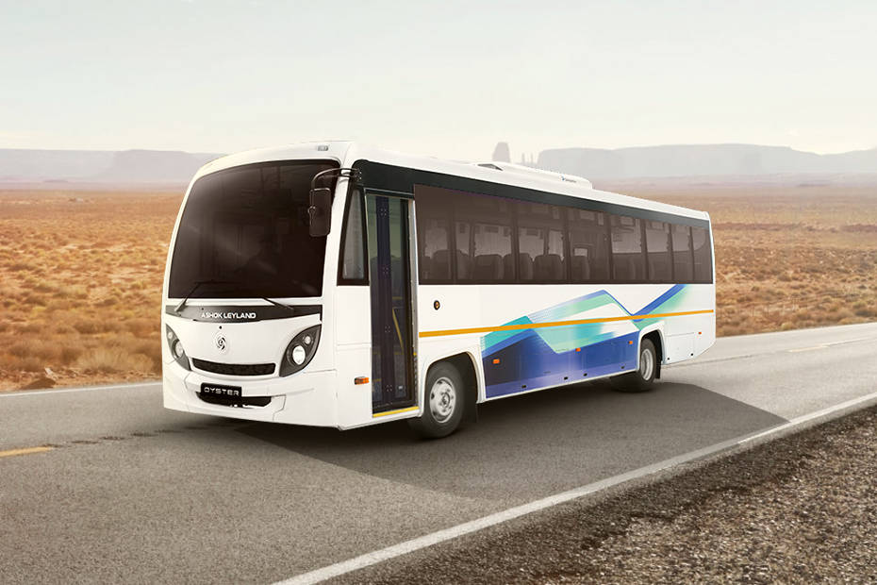
A and Aa Matra Words
Water
BUS

Slide 4
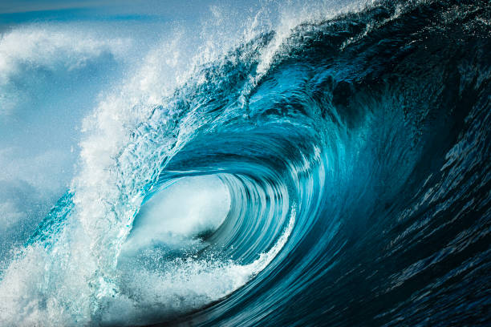
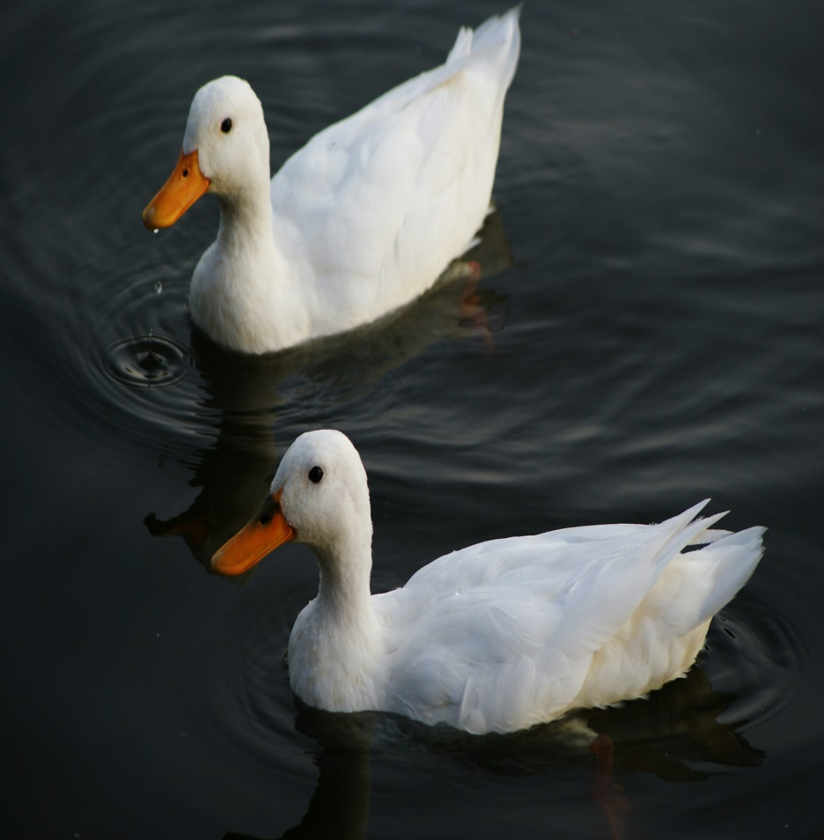
A and Aa Matra Words
Waves
Duck

Slide 5


A and Aa Matra Words
One
Letter

